Slide 1
Protein Pow(d)er
Programmeertheorie, Week 2, Presenteersessie 1
Team: Shire Peasants 3
Authors: Mark Dzoljic, Loek van Steijn, Sebastiaan Kruize

Slide 2
Format of the presentation
1. Introduction in the casus
State Space of the problem (Mark)
2. Datastructures (Terugblik vorige week) (Loek)
Dictionairy vs. Matrix
Results
3. Algorithms (Sebas)
Random, Greedy
4. Results (Sebas)
Future heuristieken (Allemaal)
5. Q&A and discussion (Mark)

Slide 3
1. Introduction: Stability of proteins
Proteins fulfill numerous function inside the human body
Consist of a ’string’ of amino-acids
Faulty proteins linked to diseases such as Alzheimers or huntington
Finding “Stable” Proteins can help in the development of farmaceuticals

Slide 4
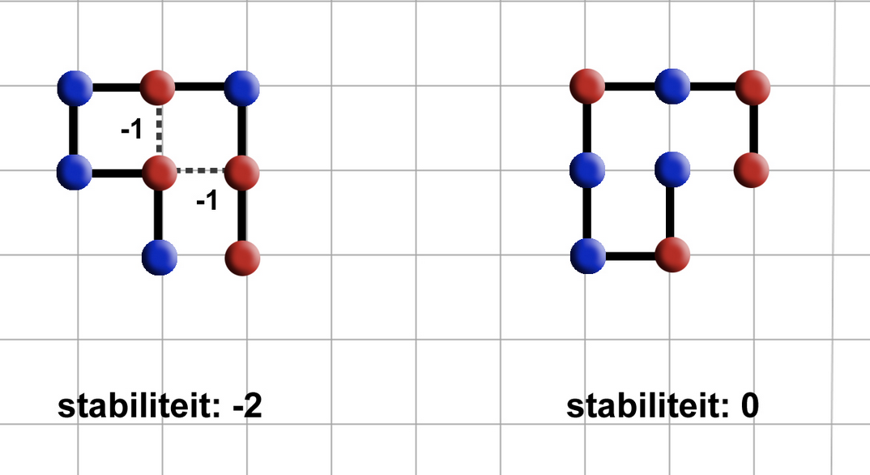
1. Introduction: Stability of proteins
Place amino-acids on a 2D-grid.
Amino acids can be hydrophic (Red) or Polair (Blue)
Red amino-acids can form bridges, and strengthen the stability
Goal is to find protein structures that are as stable as possible.

Slide 5
1. Case exploration
Constrained Optimization Problem
Constraints
Amino-acid string is given
All amino-acids must be used
Can not move ‘diagonally’ must move either left/right/up/down
Amino-acids cannot overlap
Optimization
Legitimate solution with the highest stability
State Space
4^{n}?
4*3^{n-1}
Maar: rotatie
3^{n-2}
Kan niet rekening houden met self-avoiding walk:
True State Space: < 3^{n-2}

Slide 6
2. Quick recap
Element Object
Stores: coordinates, direction, type
Lattice Object
Stores: element objects in two ways
Dictionaries
Use of dictionaries to store element objects.
Matrixes (2D or 3D grid)
Use of a matrix to store element objects.
Question: which data structure is faster?

Slide 7
3. Algorithms
Tried:
Self avoiding random walk (SARW)
SARW with a twist
Greedy
Next up:
Extended Heuristic Algorithm
Breadth-first: Beam Search

Slide 8
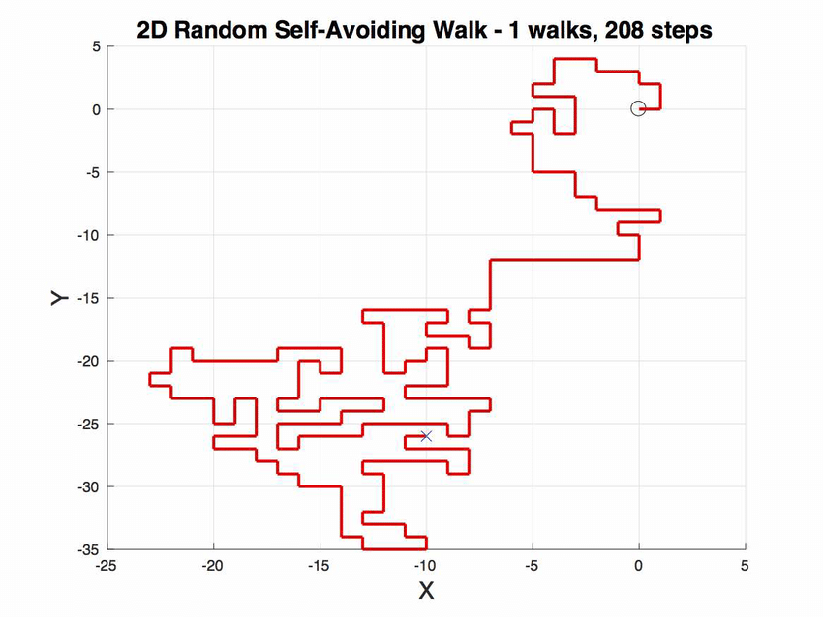
Self avoiding random walk
Let S be HP-chain of length n.
Fix first 2 elements of chain.
For subsequent elements up to the n^{th} element, choose random move from {u, d, l, r, i, o}.
If newly chosen coordinates are occupied, try new move.
Stuck? Start over.

Slide 9
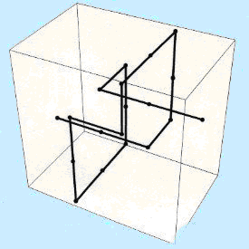
Self avoiding random walk (with a twist)
Let S be HP-chain of length n.
Fix first 2 elements of chain.
For subsequent elements up to the n^{th} element, choose random move from {u, d, l, r, i, o}.
If newly chosen coordinates are occupied, try new move.
If newly chosen coordinates are on the border, try new move.
Stuck? Start over.

Slide 10
Greedy
Let S be HP-chain of length n.
Fix first 2 elements of chain.
For subsequent elements, try all moves from {u, d, l, r, i, o} and check whether move would result in H-H connection (with self-avoidance).
If so, use the move. If not, pick random.
Stuck? Start over.

Slide 11
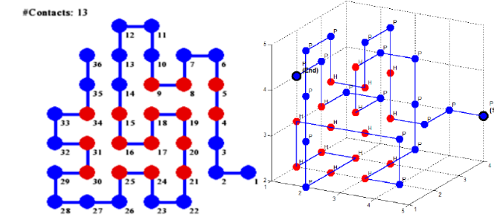
Extended Heuristic Algorithm
Divide chain S up into n parts S_{i} of predetermined length.
Fold S₁ optimally against S₀ by going through all permutations (with self-avoidance), then fold S₂ optimally against S₀ ∪ S₁, etc. up until S_{n}.
Optimal means most H-H contacts.
Source: Traykov, Metodi, et al. "Algorithm for protein folding problem in 3D lattice HP model." International Journal of Biology and Biomedicine 3 (2018).

Slide 12
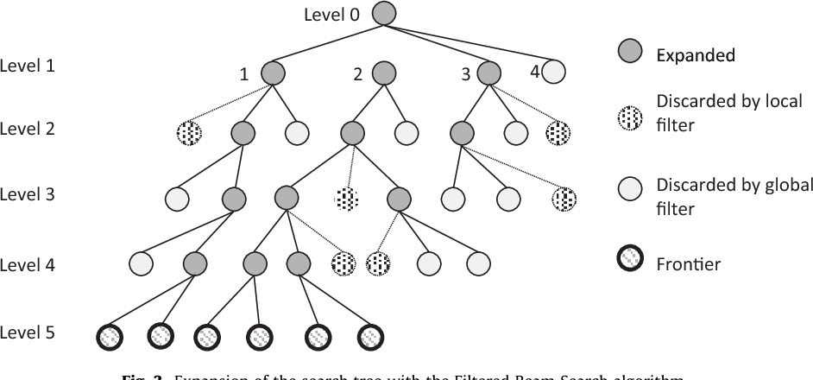
Breadth-first: Beam Search
Combination of breadth-first and greedy.
Goes through all moves from {u, d, l, r, i, o} and selects the n best moves (based on ‘beam width’).
From selected n moves, go 1 level deeper and repeat up until maximum depth.

Slide 13
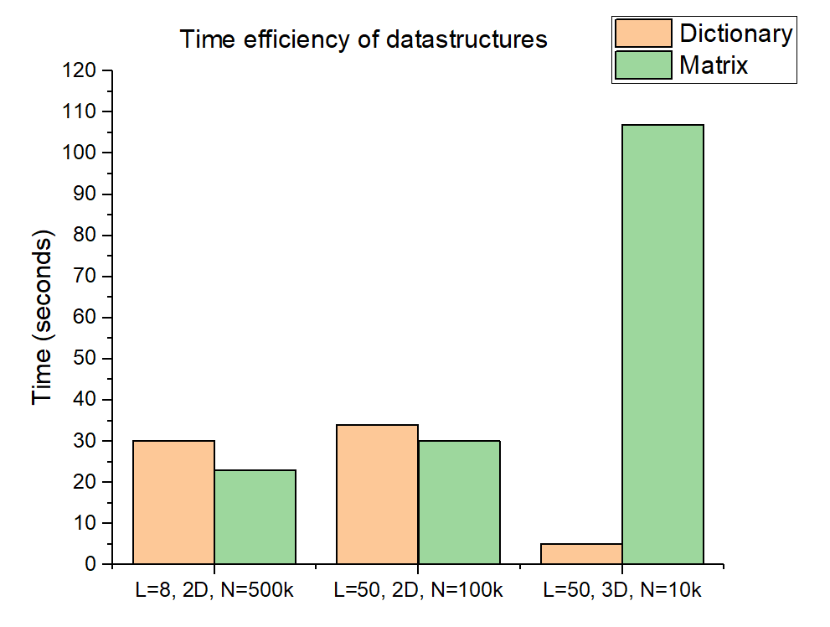
Results – Data structure
L: length of protein
N: number of iterations

Slide 14
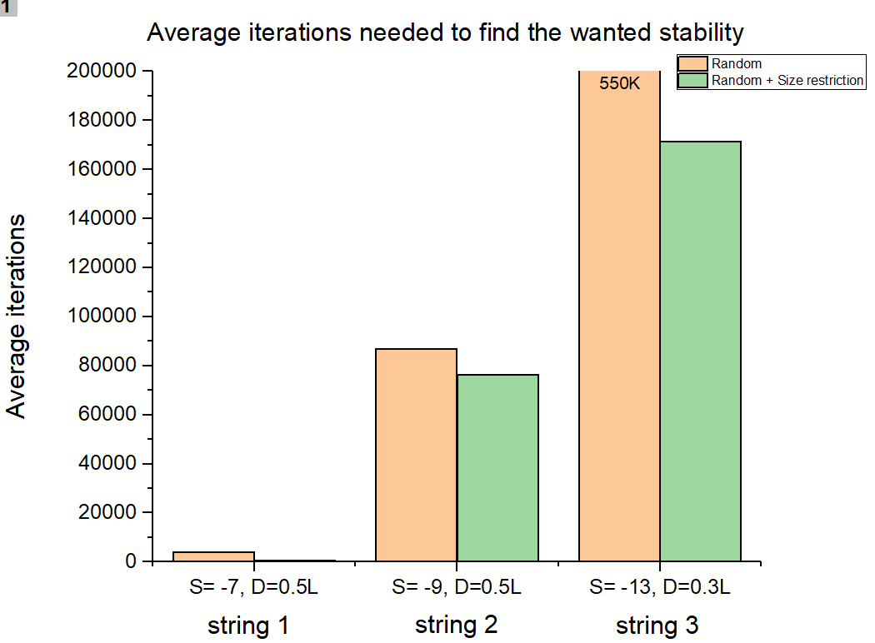
Results – Size restricted configuration
S: wanted stability
D: dimension of matrix
L: length of protein
String 1 (L=14): HHPHHHPHPHHHPH
String 2 (L=20): HPHPPHHPHPPHPHHPPHPH
String 3 (L=36): PPPHHPPHHPPPPPHHHHHHHPPHHPPPPHHPPHPP

Slide 15
Conclusions
Data structures
Size restriction
Situation | Matrix (time) | Dictionary (time) | Improvement
L=8, 2D, N=5E⁵ | 23 s | 30 s | +23%
L=50, 2D, N=1E⁵ | 30 s | 34 s | +12%
L=50, 3D, N=1E⁴ | 107 s | 5 s | -2040%
Size restriction D=0.5L | 3 s | 5 s | +40%
Situation | Random iterations | Size restricted iterations | Improvement
S=-7, L=14, D=0.5L | 4076 | 555 | +86%
S=-9, L=20, D=0.5L | 86881 | 76272 | +12%
S=-13, L=36, D=0.3L | 530253 | 171503 | +67%

Slide 16
3. Algorithms
Suboptimal results:
Random
Greedy
Optimal results
Linear algorithm

Slide 17
4. Method: Possible algorithms
Name | Result | Method | Ω (Best Case) | Runtime (1000 iterations) Dict | Runtime (1000 iterations) Matrix
Random | Sub-optimal | Constructive
Greedy | Sub-optimal+ | Constructive
Lineair | Optimal | Constructive
Future | - | -

Slide 18
Future:
Welke heuristieken gaan we komende week aan werken.

Slide 19
Questions and comments?
Our questions:
All our algorithms are ‘constructive’. Ideas where to think regarding iterative algorithms?
What is your view on our choice for datastructure?
Thank you for your attention

